Slide 1
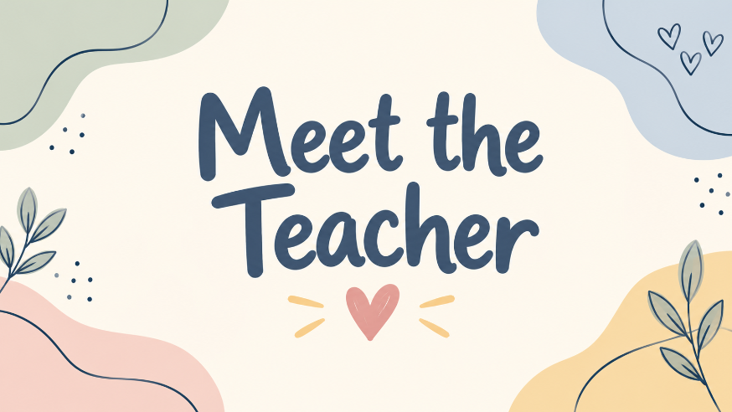

Slide 2



Slide 3
Our Team:
Miss Moseley – Class Teacher
Miss Mac – PPA Cover (Wednesday PM) and class TA on Mondays, Tuesdays and Thursdays
Miss Middlehurst – TA on Tuesdays, Wednesdays and Fridays
Mrs Khan – Class TA

Slide 4
Our School Day
Gates open at 8:35am
First bell – 8:40am
KS2 Door closes at 8:45am
Second bell – 8:50am
School day finishes at 3:10pm

Slide 5
Personal, Social, Health and Economic Education (PSHE)
This year, we will be following the Kapow Primary RSE & PSHE scheme, supporting children to develop the knowledge, confidence and skills they need to navigate everyday life.
Our learning will focus on:
Healthy relationships: Building friendships, showing kindness, respect and understanding others.
Health and wellbeing: Understanding emotions, mental health and how to maintain a healthy lifestyle.
Online safety: Making safe and responsible choices when using technology.
Staying safe: Recognising potential risks, understanding personal boundaries and knowing when to seek help.
Growing and changing: Developing an age-appropriate understanding of how our bodies and feelings change.
Life skills: Developing independence, decision-making and an understanding of the wider community.
Lessons will involve discussions, stories, activities and opportunities for children to share their thoughts in a safe and supportive environment.

Slide 6
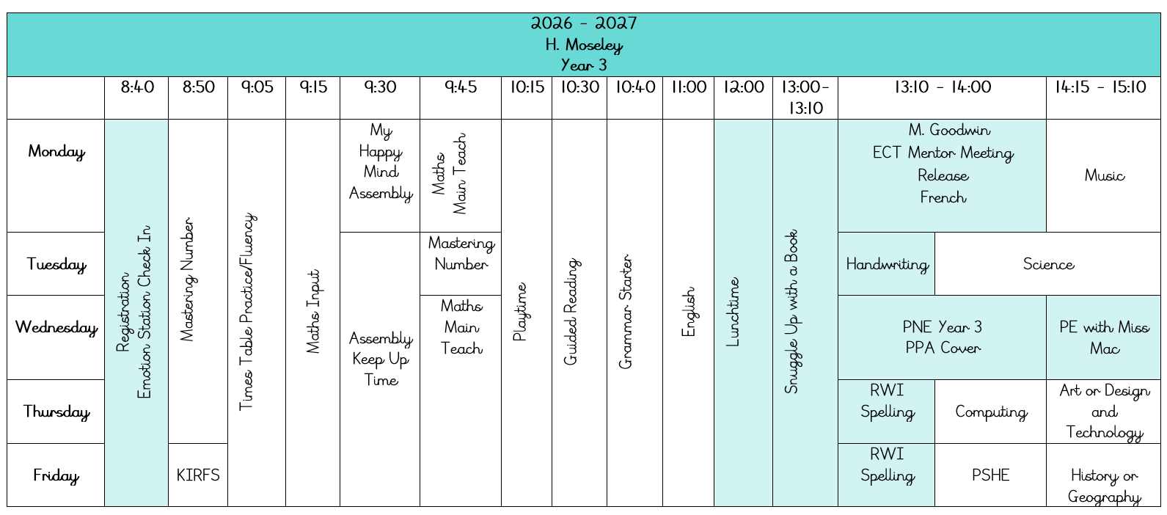
Timetable

Slide 7
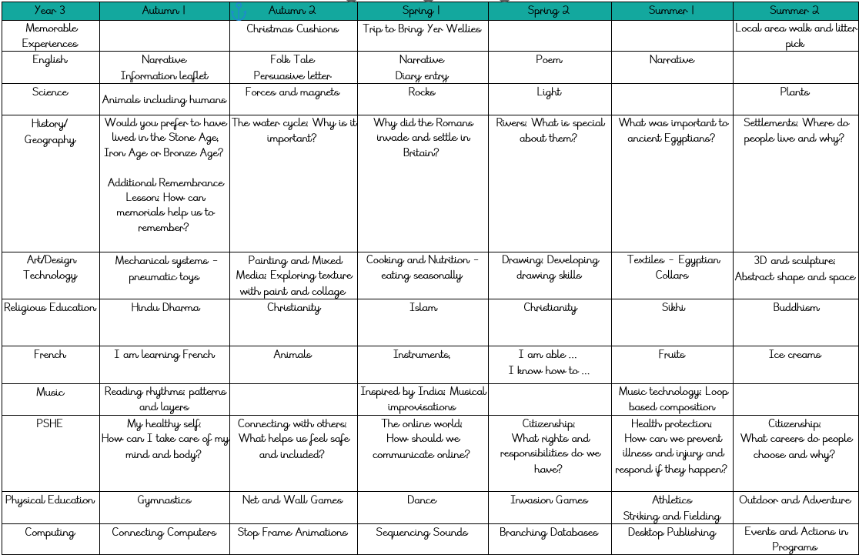
Year Three Long Term Plan

Slide 8
Reading
In Year 3 the expectation is to read 3-4 times a week for 10 minutes, each day.
Please sign their book once read so we can change it in school.
Children will choose their own new reading book, to encourage enjoyment and independence.

Slide 9
Keeping in Touch
To keep in touch, please keep an eye on Class Dojo to see what is going on ☺
Also, you can contact myself or any of our other lovely team by calling the office or speaking to us at the start or end of the day.

Slide 10
Thank you! ☺
Any questions?

