Slide 1
Meet the Teacher
Miss WILDMAN & Mrs Rowland ☺
Welcome to you all.

Slide 2

School staff
There are 4 members of staff working in Year 2.
Class teachers – Miss Wildman (Mon, Tues & Wed am) & Mrs Rowland (Wed pm, Thurs & Fri)
Teaching Assistants – Mrs Middlehurst
PPA & Leadership Cover – Miss Mac

Slide 3
A little bit about me
Hi, I am Miss Wildman.
Teaching at Brookfield for 9 years now.
Worked in KS2 and KS1
Computing and phonics lead.
Recently came back from maternity leave.
Currently now teaching part time.

Slide 4
A little bit about me
Hi, I am Mrs Rowland.
This is my 12th year teaching at Brookfield!
I have taught mainly in KS1 but also a few years in KS2.
I am the school's SENCo and lead on PSHE and music.
I spend half of my week fulfilling SEND responsibilities and half of my week with the lovely year 2s!
I too have recently returned from maternity leave and have 2 children, Theo 6 and Grace 1.

Slide 5
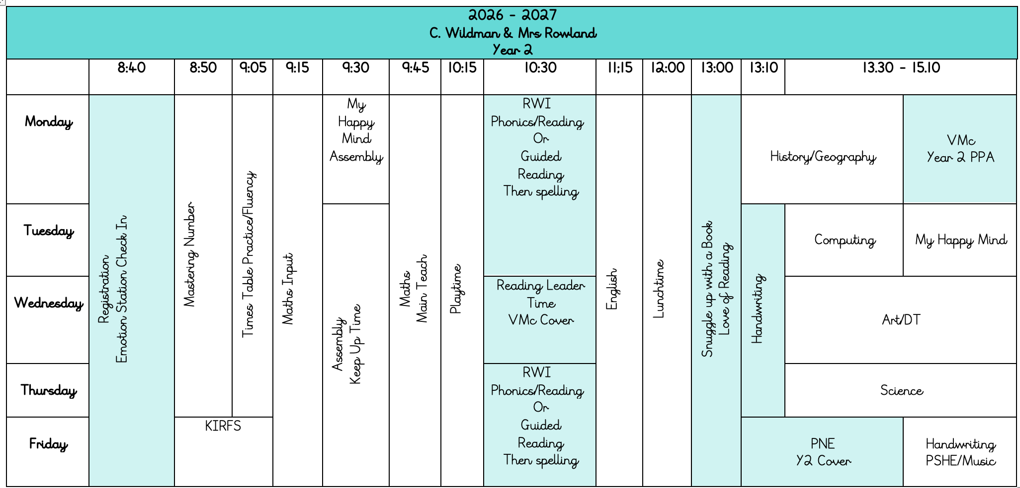
Year 2 Week

Slide 6

School day
Teaching assistants and teachers will at the door at 8.40am and our school day starts with Maths.
Our school day ends at 3.10pm.

Slide 7
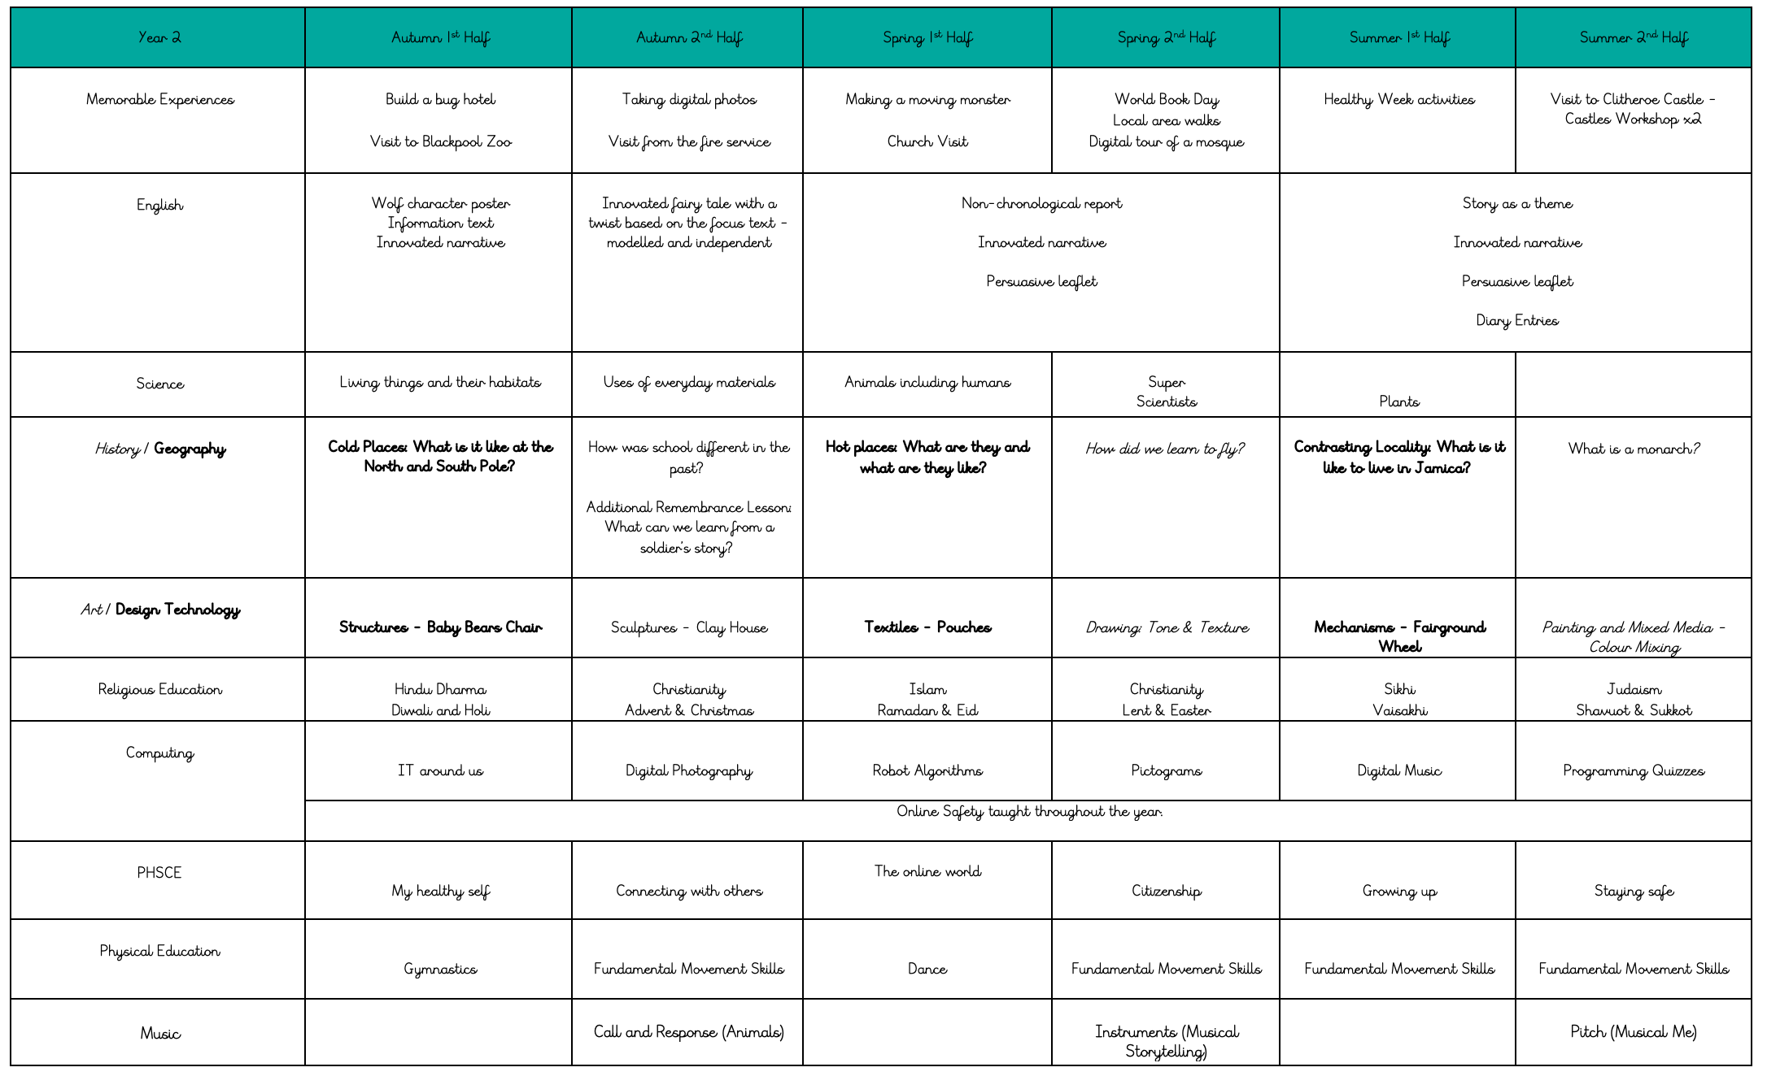

Slide 8
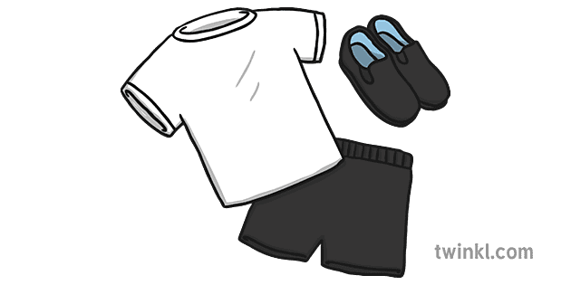
School Uniform - pe
Our PE day is Friday..
PNE will be taking our PE lesson. Children must come in their kit that day.
School Uniform – PE:
- Teal school hoody (with logo) or school jumper.
- White t-shirt (with/without logo)
- Plain black shorts, tracksuit bottoms or leggings.
- Black/grey socks.
- Trainers or black pumps.
Please ensure all uniform is labelled to prevent items going missing.

Slide 9
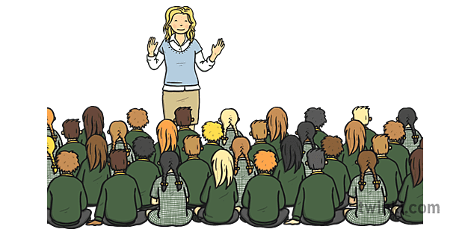
Assemblies
Each Friday, we have a superstar assembly.
You will be invited via text on Thursday to attend on Friday if your child is receiving the certificate.
2 people per child.
Class Assembly – TBC.

Slide 10
Reading and phonics
In Year 2, children will bring home a new reading book every week. This book links with the sound/level they are learning in their session or reading level. Reading lesson are a mix of phonics & guided reading in Year 2.
We would love children to read a bit of their book every night. We do understand this may not be possible with day to day life but our expectation is read for 5-10 minutes 3 times a week.

Slide 11
Keeping up to date
Class Dojo
- Class pages on the school website.
If you need to contact me, please call the office.

Slide 12
Thank you so much for coming!
Any questions?

