Slide 1
Meet the Teachers
Mrs Rowland, Miss McElhone and Miss Campbell
Welcome to you all.

Slide 2

School staff
There are 3 members of staff working in The Cabin.
Class teachers – Mrs Rowland Monday, Tuesday, Wednesday (am), Friday (pm)
Teaching Assistants – Miss McElhone and Miss Campbell

Slide 3
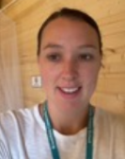
A little bit about me
Hi, I am Mrs Rowland.
This is my 12th year teaching at Brookfield!
I have taught mainly in KS1 but also a few years in KS2.
I am the school's SENCo and lead on PSHE and music.
I spend half of my week fulfilling SEND responsibilities and half of my week with the lovely year 2s!
I too have recently returned from maternity leave and have 2 children, Theo 6 and Grace 1.

Slide 4
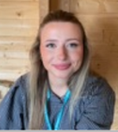
A little bit about me
Hi, I am Miss McElhone,
I am new this year but have also volunteered at other schools as well at Brookfield in the past.
I have a level 3 diploma in Health and Social Care.
I've enjoyed spending time with the boys and can't wait to see them flourish!

Slide 5
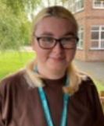
A little bit about me
Hi, I am Miss Campbell,
I am a new face at Brookfield!
I used to work at an after-school club, helping the children with their activities and their fun!
Getting to know the little ones has been a joy so far, and I can't wait to learn more about them!

Slide 6
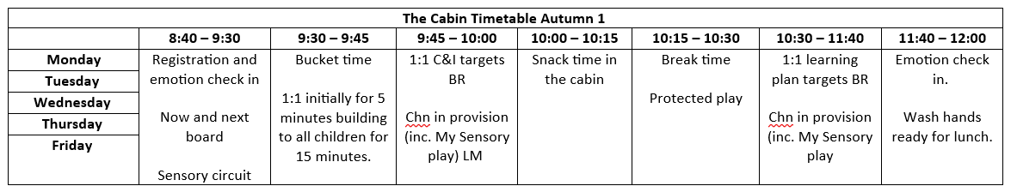
The Cabin Timetable
Notes:
Our timetable is quite flexible and we will be lead by the children and change the timetable to fit their needs.
There is lots of opportunity for the children to access provision which is based on the equals curriculum.
Our key thread is communication and interaction and this will be a focus throughout the year.

Slide 7
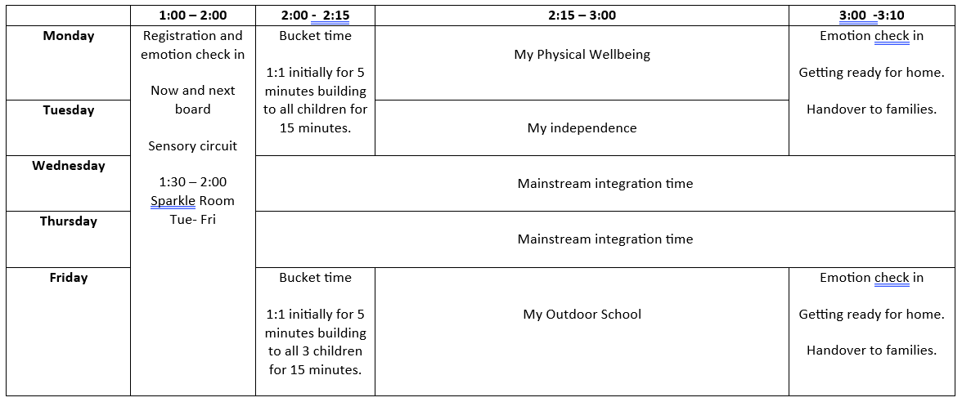
The Cabin Timetable
Notes:
The children spend time within their mainstream year group twice a week to build relationships with peers and help them to have a sense of belonging to their year group as well as our little class.

Slide 8

School day
A member of staff will meet the children at the mainstream class door each morning.
Our school day ends at 3.10pm and a member of staff will release your children from their mainstream classroom door.

Slide 9



Our curriculum
We have bought the equals curriculum which is used in some specialist settings.
We are currently using the pre-formal curriculum but also have access to the semi-formal curriculum if the needs of the children require this.
We have 5 strands – our key strand running through everything is communication and interaction.

Slide 10
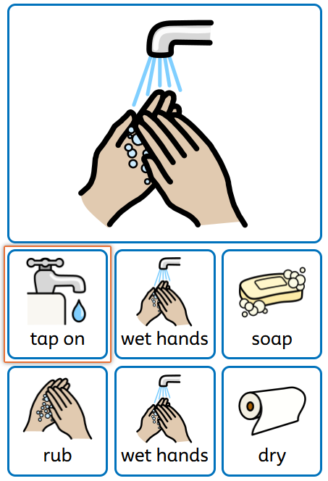

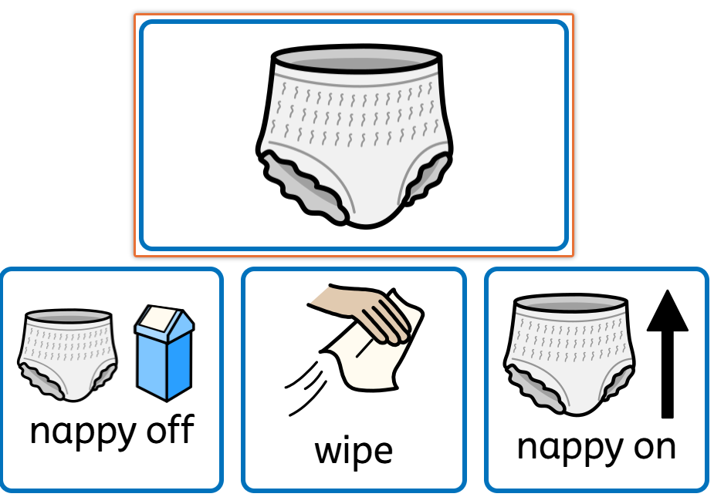
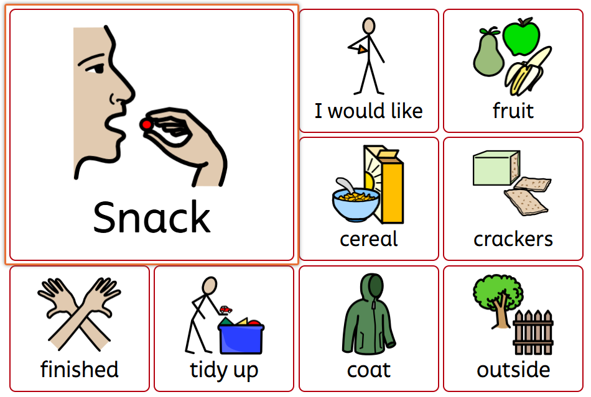

Widgit

Slide 11
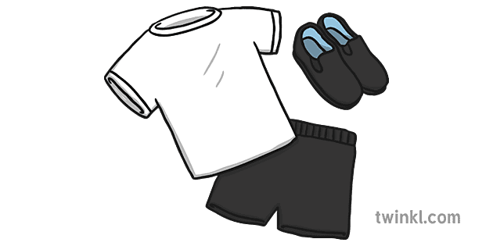
School Uniform
The children have access to outdoor play throughout the day – we have a sheltered outdoor area! Please make sure they have an appropriate coat, especially as the weather starts to change. We have puddle suits and wellies in school for them to use if needed!
We will be completing ‘My Outdoor School’ on a Friday – during this time we will spend time outdoors. If you wish to send your child in wearing their PE uniform (black tracksuit bottoms, PE top, school jumper or hoodie and black trainers) then please do!

Slide 12
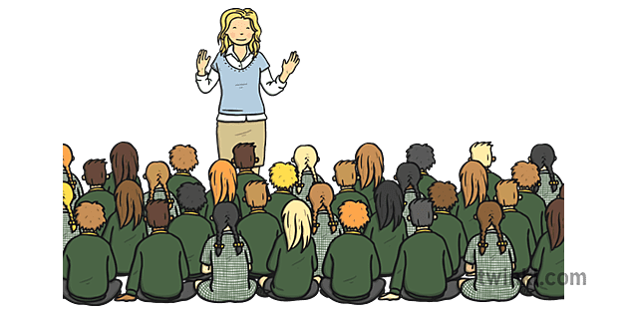
Assembly
Each Friday, we have a superstar assembly.
You will be invited via text on Thursday to attend on Friday if your child is receiving the certificate.
2 people per child.

Slide 13
Keeping up to date
Class Dojo
- Class pages on the school website.
If you need to contact me, please call the office.

Slide 14
Thank you so much for coming!
Any questions?

