Slide 1
Year 3
Meet the teacher

Slide 2
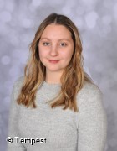
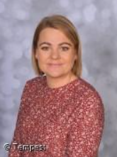
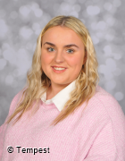
Class Staff
Miss Reeder – Class Teacher
Miss Mac –PPA Cover
PNE – PE
Mrs Wilkinson –Teaching assistant
Miss Ramshaw – Teaching assistant

Slide 3
Attendance and punctuality
Teachers and teaching assistants are outside from 8:40am and our school day starts straight away with maths.
Our school day ends at 3:10pm.

Slide 4
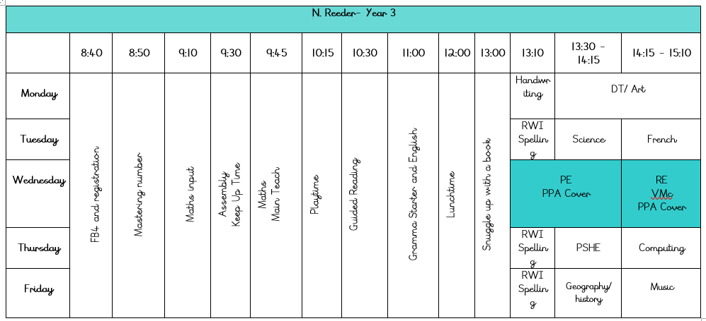
A typical week in Year 3

Slide 5
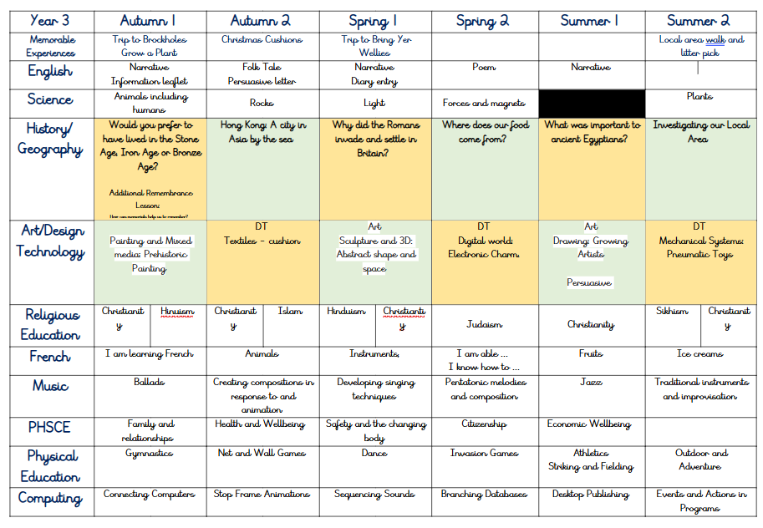
Hinduism

Slide 6

Our PE day is Wednesday. PE sessions will be done with PNE and Mrs Wilkinson present.
On this day, children can wear:
School Uniform – PE:
- Teal school hoody (with logo) or school jumper.
- White t-shirt (with/without logo)
- Plain black shorts, tracksuit bottoms or leggings.
- Black/grey socks.
- Trainers or black pumps.
Earrings must be removed or taped at home.
School Uniform
PE kit

Slide 7
Each Friday, we have a superstar assembly.
You will be invited by text on Thursday to attend on Friday if your child is receiving the certificate.
2 people per child.
Class Assembly:
I will send a reminder 2 weeks before.
Assemblies

Slide 8
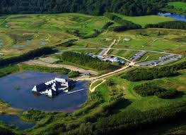
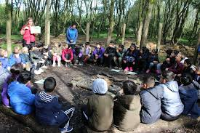
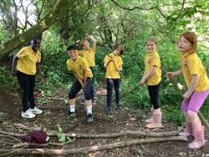
School Trip
Memorable Experience – Brockholes Wood
Tuesday 21st October
Payment to be made on Parent Pay.
9:00am – 3:00pm

Slide 9
Reading
In Year 3 the expectation is to read 3-4 times a week for 10 minutes, each day.
Please sign their book once read so we can change it in school.
Children will choose their own new reading book, to encourage enjoyment and independence.
If children do not read at least 3 times per week, they will do it during their own time in school.

Slide 10
Assessment
Once a term, the children take part in assessments called NFER’s. These are completed over 5 days. They allow us to track the progress of the children and establish where intervention/challenge is needed. The children have completed these in previous years and it’s ‘normal’ to them and is always a positive experience.
Spelling – Each week the children are given 6 spellings to practice for a spelling test on Friday.

Slide 11
Keep up to date with what’s happening on:
- Class Dojo
- Class pages on the school website.
Contact me by:
- Calling the office to arrange call/meeting
Start/End of day
You cannot contact me on Dojo

Slide 12
THANK YOU
Any Questions?

